Slide 1
Note-taking and Summarizing
Content Area Reading
4th Grade Class
Hope Argo
Northside Elementary
Rogers, AR
December 13, 2011

Slide 2
Purpose of the GANAG Structure
To give students the opportunity to actively use the nine high-yield strategies:
(2) Identifying Similarities and Differences
(7) Cooperative Learning
(8) Setting Objectives and Providing Feedback
(3) Summarizing and Note Taking
(4) Reinforcing Effort and Providing Recognition
(9) Generating and Testing Hypotheses
(5) Homework and Practice
(10) Cues, Questions and Advance Organizers
(6) Nonlinguistic Representations

Slide 3
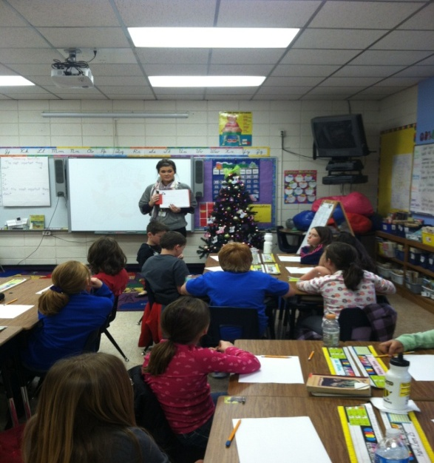
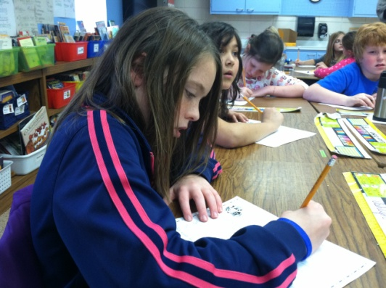
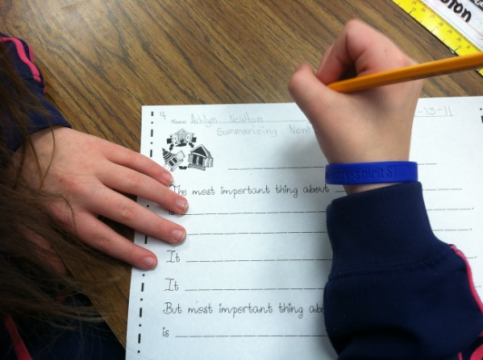
G= Goal
I can identify important ideas and provide details for each important idea.
R.9.4.12
Summarize content of selection, identifying important ideas and providing details for each important idea
CCSS: RI.4.2
Determine the main idea of a text and explain how it is supported by key details; summarize the text
Prior to this lesson, students showed their secret score at the beginning of each lesson. Ms. Argo wanted to gradually transition them to writing their score in an interactive notebook. For this lesson, they recorded their score on their activity page.
(8) Setting Objectives and Providing Feedback

Slide 4
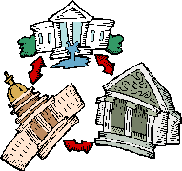
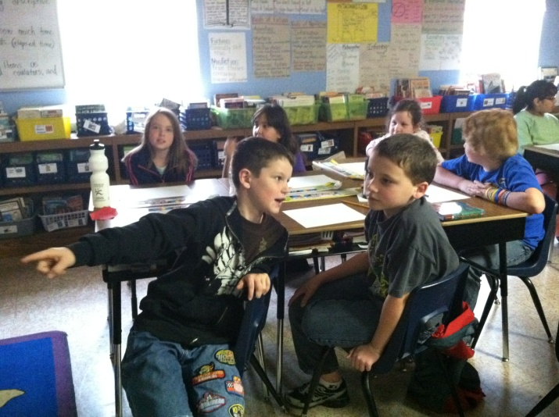
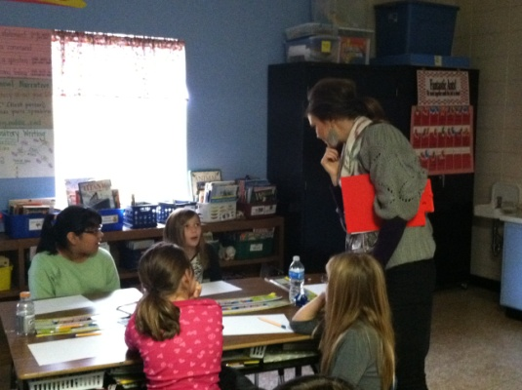
A= Access Prior Knowledge
Ms. Argo:
“Look at this picture. What do you think it represents?”
Students turn and talk to their partner about the picture.
“I think it means that the white house works with the other two branches, and the other branches work together too. They all need each other to do their jobs. “
Ms. Argo listens in as pairs discuss.
(6) Nonlinguistic Representations

Slide 5

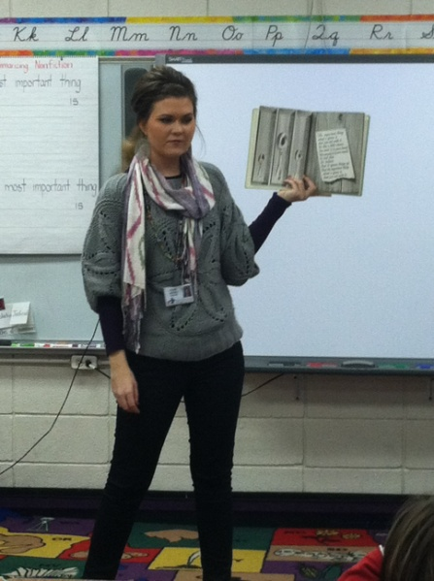
N= New Information
Ms. Argo introduced The Important Book by Margaret Wise Brown.
“Your purpose for listening is to think about how the author might have decided what was important about each object.”
The class identified the important idea about each object in the book. They also discussed the details provided for each object.
(10) Cues, Questions and Advance Organizers

Slide 6
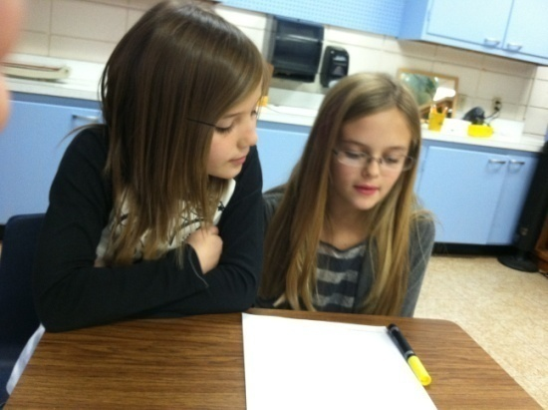
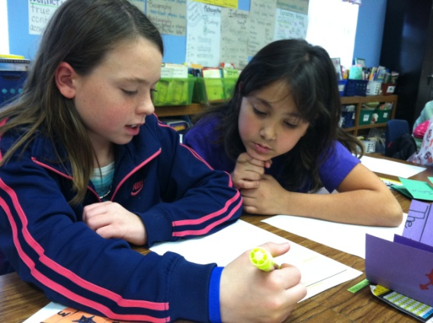
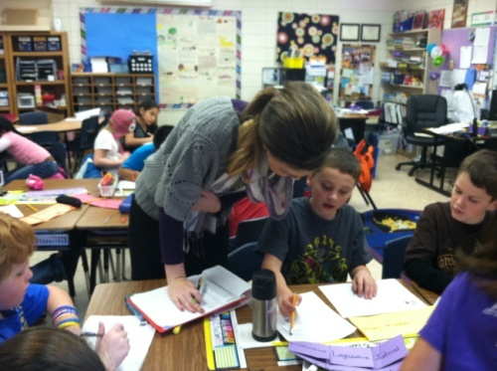
A= Apply Knowledge
Students worked with a partner to read an informational article about a branch of the United States government.
They highlighted the information that they thought was important.
Ms. Argo checked in with students to monitor and assess their strategy for determining importance. She marked her scoring guide accordingly.
(3) Summarizing and Note Taking
(5) Homework and Practice
(7) Cooperative Learning
(8) Setting Objectives and Providing Feedback

Slide 7
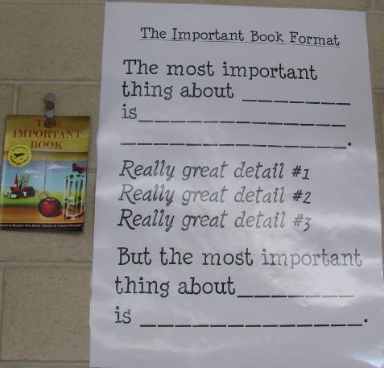
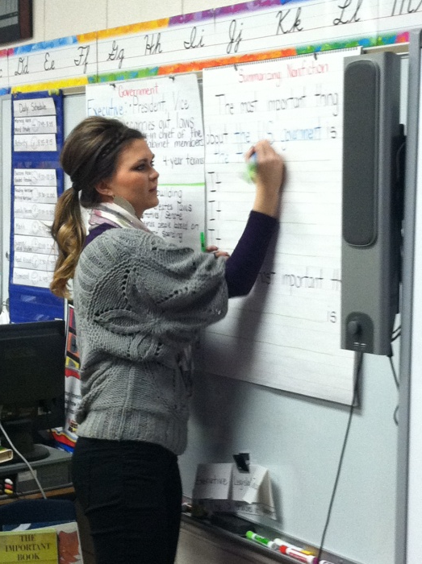
N= New Information
The class discussed the format of The Important Book. Ms. Argo showed them a sample graphic organizer that outlined the book’s format.
She modeled how to complete the organizer using important information from an article about the United States government.
(3) Summarizing and Note Taking
(10) Cues, Questions and Advance Organizers

Slide 8
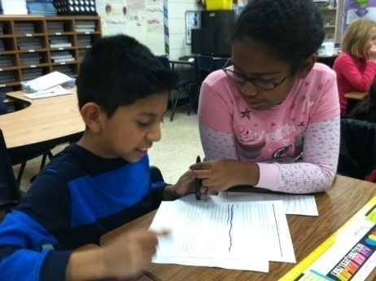
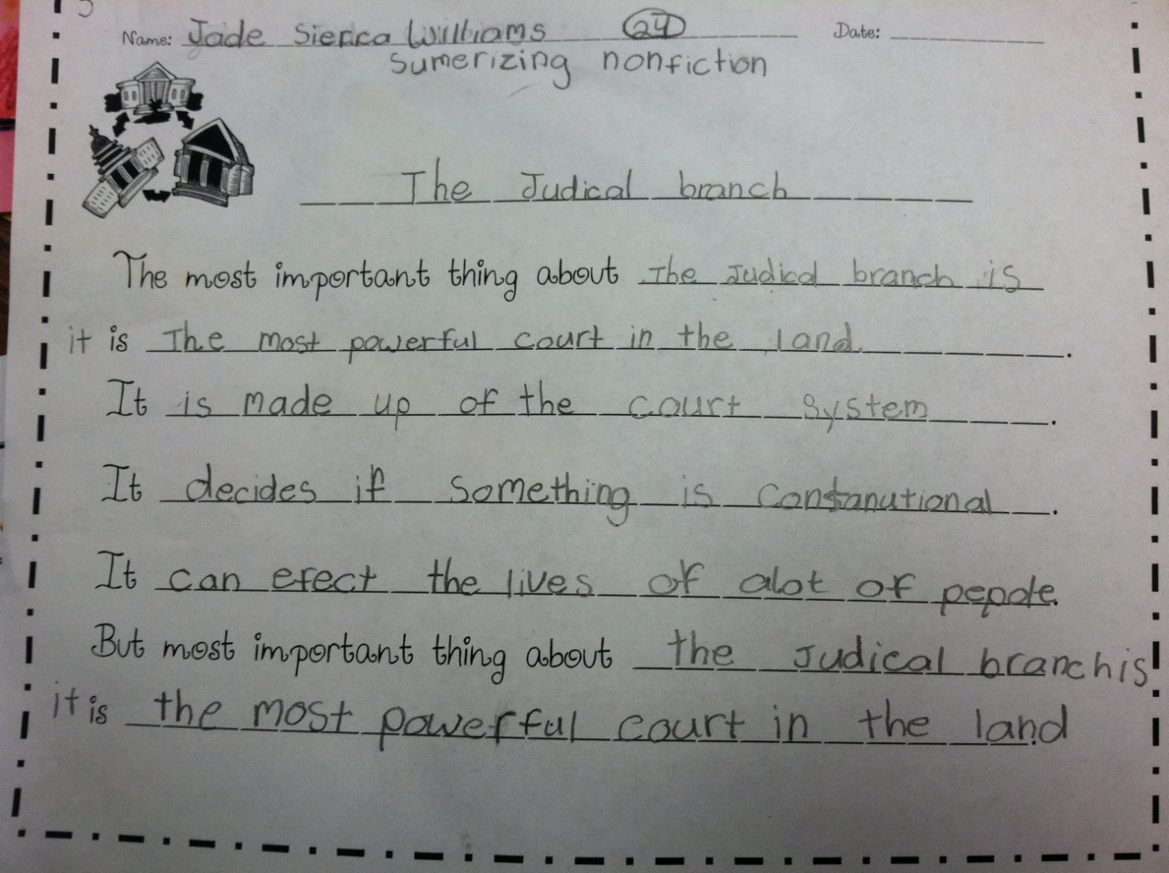
A= Apply Knowledge
Students reviewed their highlighted notes to determine which information was the most important idea.
They used the highlighted information to complete the organizer.
(3) Summarizing and Note Taking
(7) Cooperative Learning
(8) Setting Objectives and Providing Feedback

Slide 9
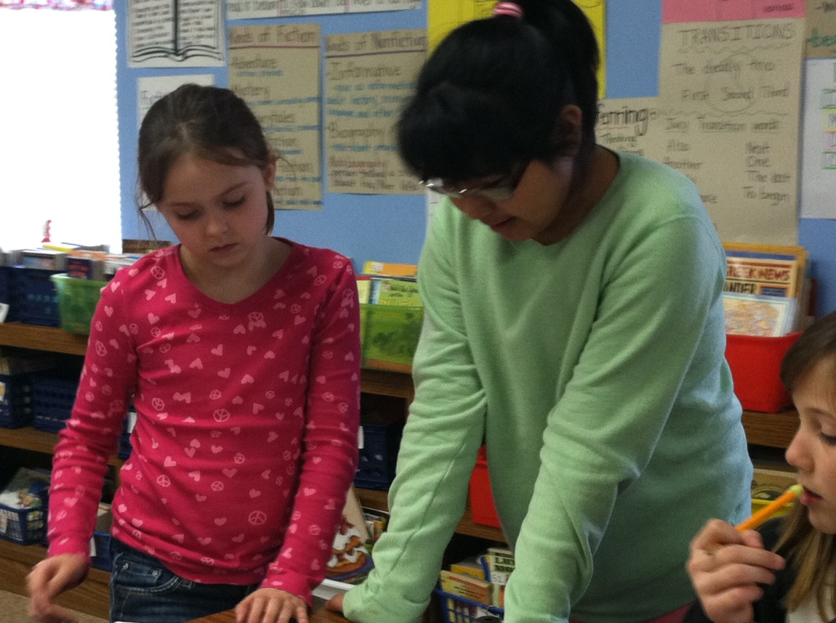
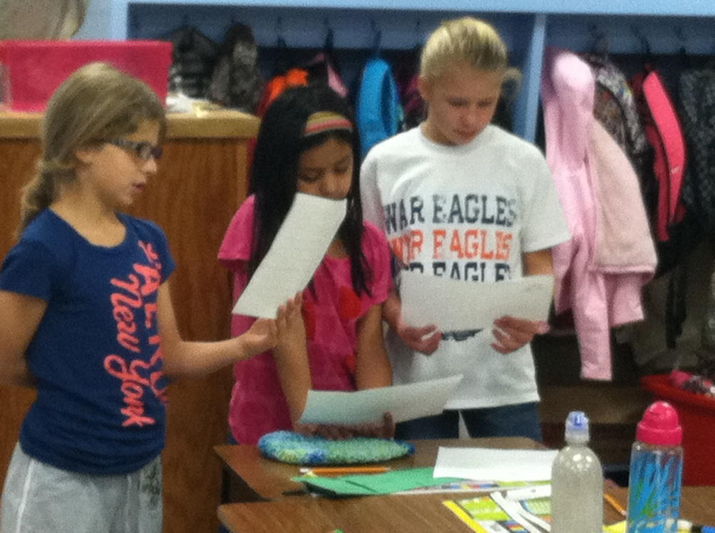
A= Apply Knowledge
Groups shared their important summaries with the class.

Slide 10
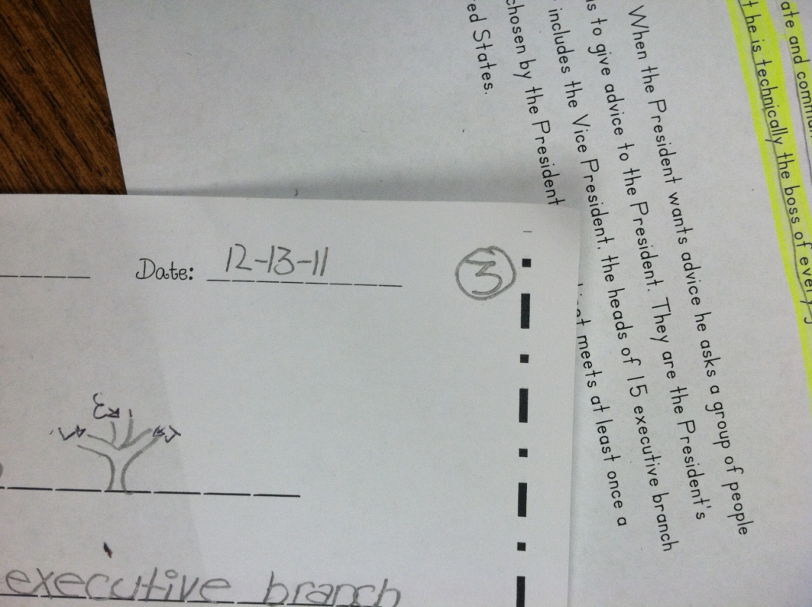
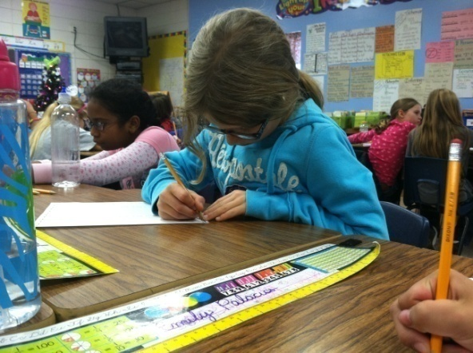
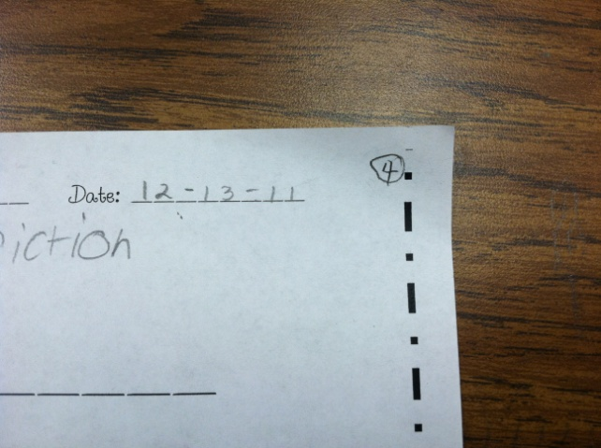
G= Goal
Students revisited the goal and scored themselves again.
“First I gave myself a 4. When we practiced I found out it wasn’t as easy as I thought so now I’m a 2. That means I need to get better.”
(8) Setting Objectives and Providing Feedback

Slide 11
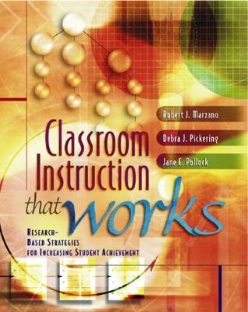

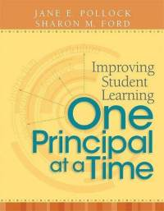
Marzano, R. J., Pickering, D. J., & Pollock, J. E. (2001). Classroom instruction that works: Research-based strategies for increasing student achievement. Alexandria, VA: Association for Supervision and Curriculum Development.
Pollock, J. E. (2007). Improving student learning one teacher at a time. Alexandria, VA: Association for Supervision and Curriculum Development.
Pollock, J. E., & Ford, Sharon M. (2009). Improving student learning one principal at a time. Alexandria, VA: Association for Supervision and Curriculum Development.

